Slide 1

Topic: Measurement
EQ: How do we work out the areas of simple shapes?

Slide 2
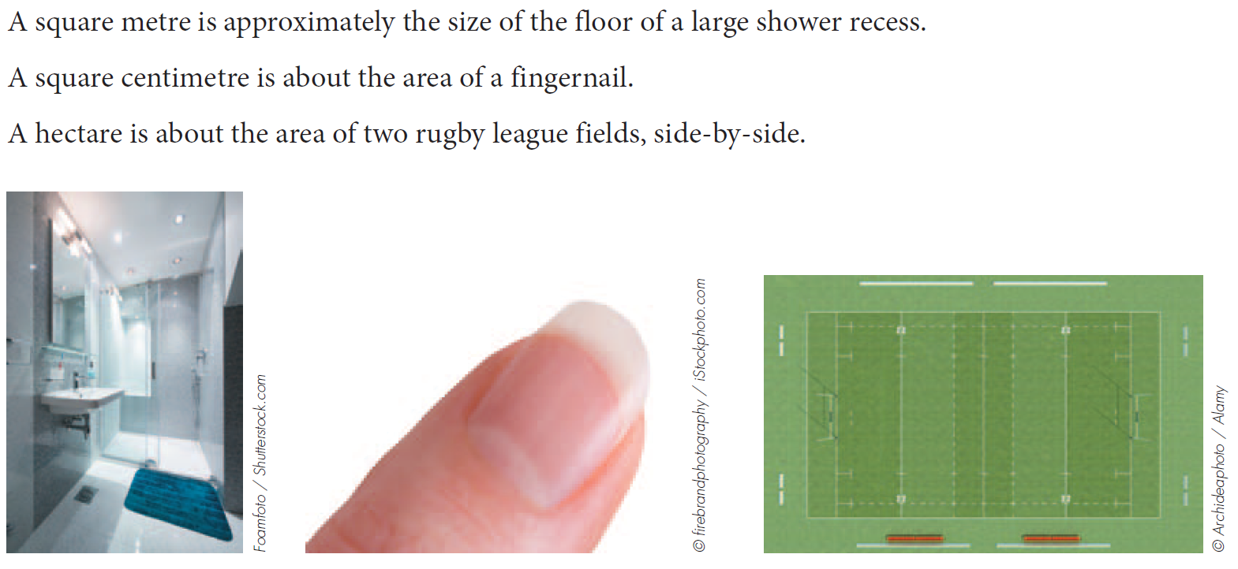
Topic: Measurement
EQ: How do we work out the areas of simple shapes?
The area of a shape is the amount of surface enclosed by that shape.
It is measured in square units which are based on the length units.
What is Area?

Slide 3
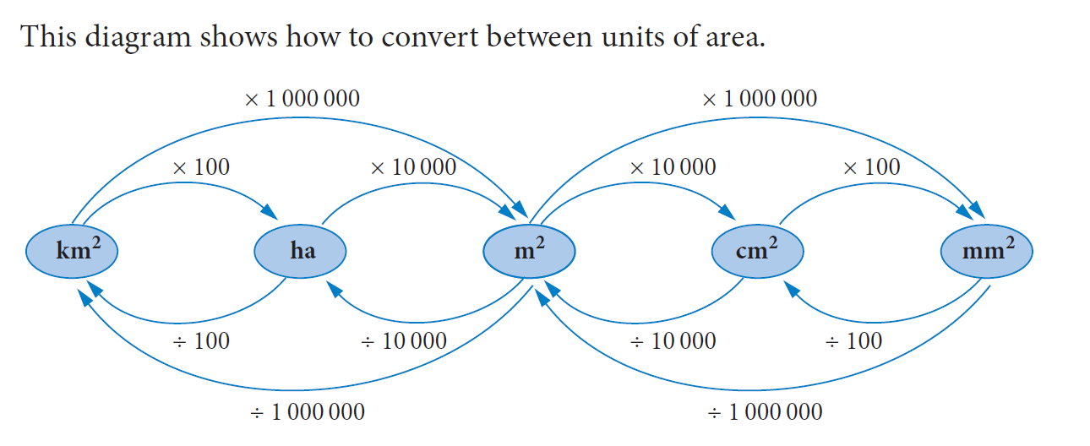
Area Unit Conversion

Slide 4
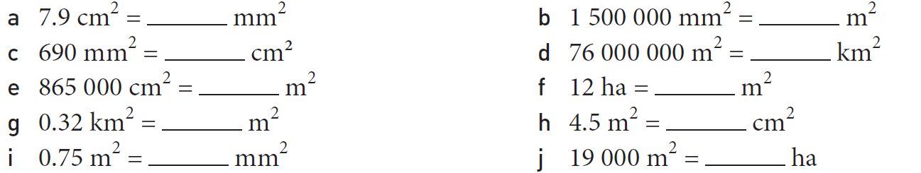

Slide 5
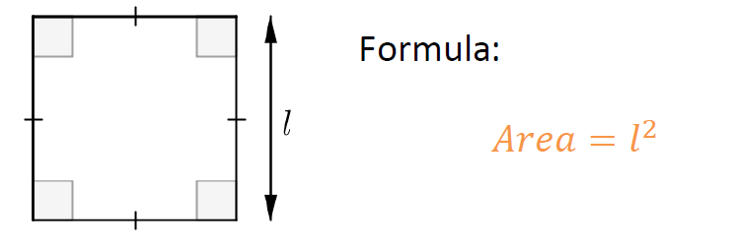
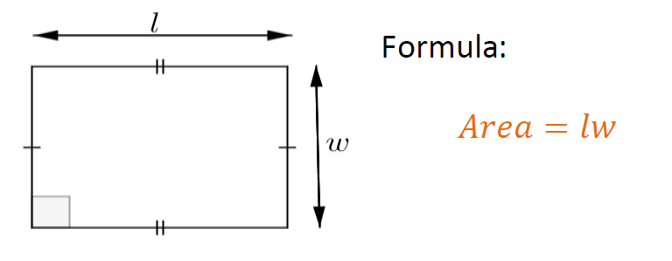
Topic: Measurement
EQ: How do we work out the areas of simple shapes?
Square
Rectangle

Slide 6
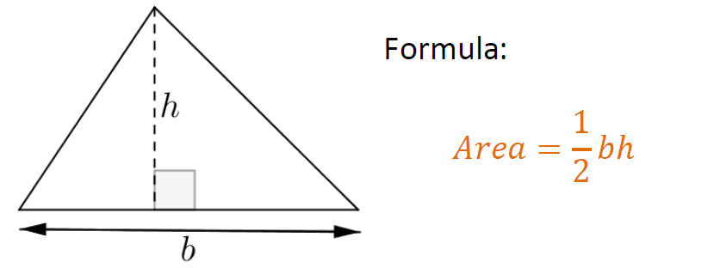
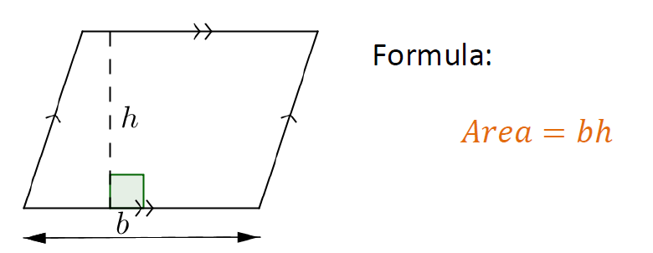
Topic: Measurement
EQ: How do we work out the areas of simple shapes?
Triangle
Parallelogram

Slide 7
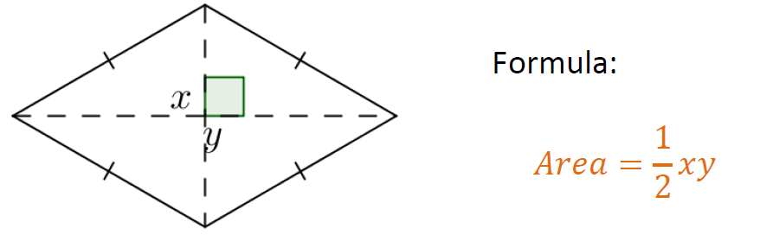
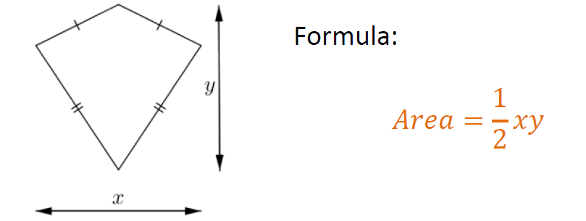
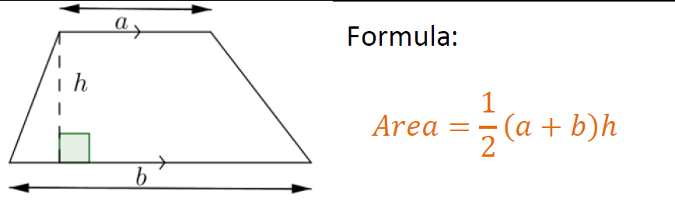
Topic: Measurement
EQ: How do we work out the areas of simple shapes?
Rhombus/Kite
Trapezium

Slide 8
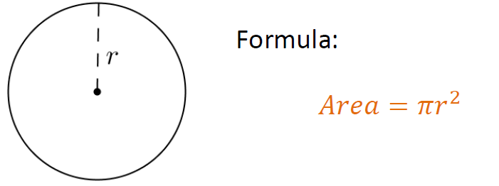
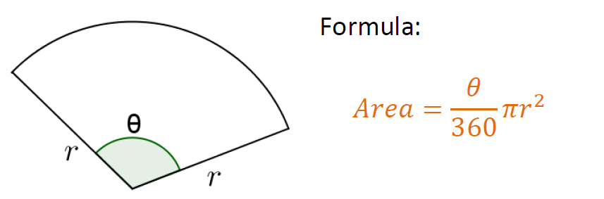
Topic: Measurement
EQ: How do we work out the areas of simple shapes?
Circle
Sector

